Slide 1


Slide 2

CI/CD Jenkins
Parth Adroja (parth.adroja@colorado.edu)
Interdisciplinary Telecom Program (ITP)

Slide 3
GitHub Repo
https://github.com/parthadroja5795/hackcu_vi

Slide 4
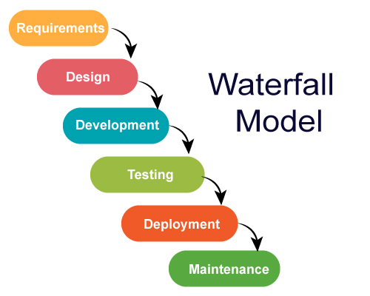
Software Development

Slide 5
PROBLEM
Slow
Less Flexibility
No product until the later stage
Manual Testing

Slide 6



Slide 7
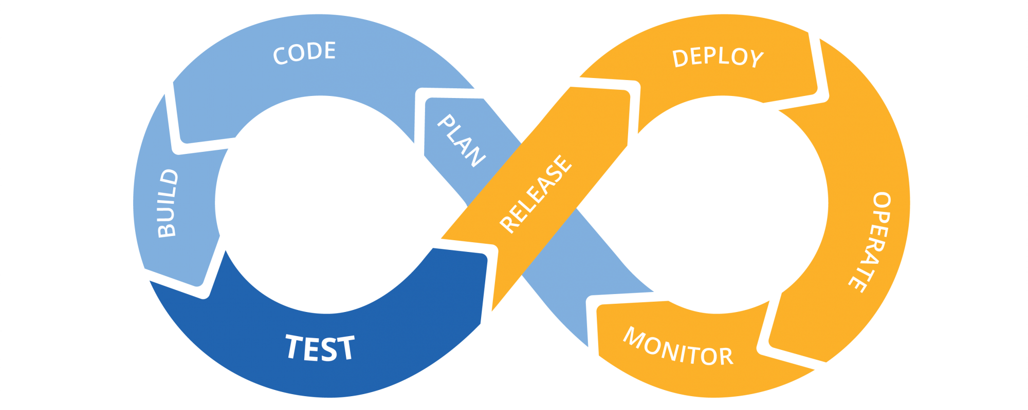
CI/CD

Slide 8


Slide 9
Hopefully!!
Let’s see how it works!!
Download Jenkins: http://mirrors.jenkins.io/war-stable/latest/jenkins.war

Slide 10
PIPELINE
GitHub
Test Connectivity
Testing
Deploy in Production
Post Checks

Slide 11
BENEFITS
Cost
Fast Release
Less MTTR
Flexible

Slide 12
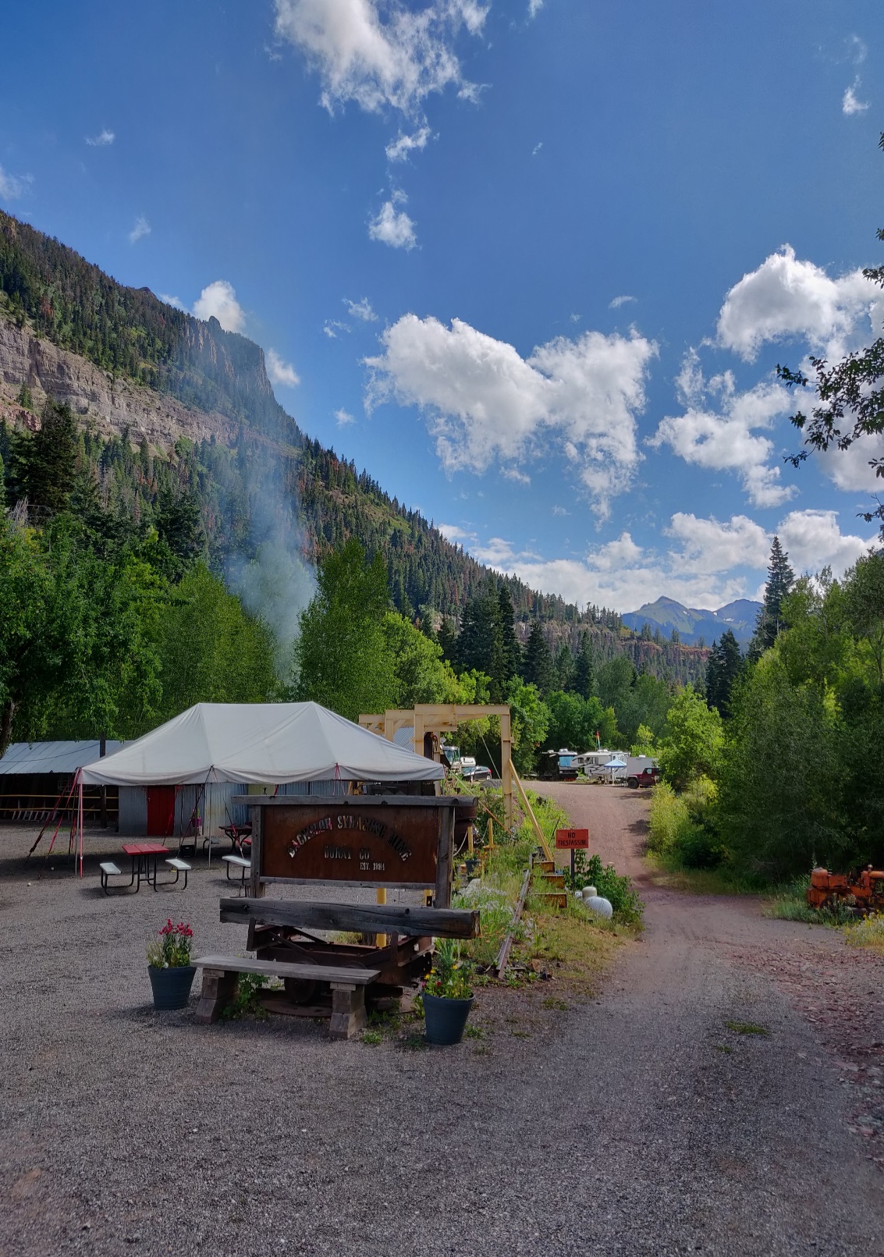
QUESTIONS?
parth.adroja@colorado.edu
github.com/parthadroja5795/

Slide 13


